Slide 1
Binary Classification Machine Learning Models for Diabetes Prediction
Group 5
May, 3rd, 2019

Slide 2
Agenda
01
Business Problem
02
Business Solution
03
Data Science Solution

Slide 3
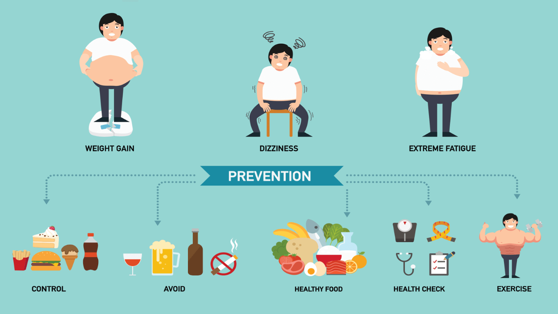
Business Problem Statement
What’s the situation?
About 1/7 U.S. adults has diabetes now.
By 2050, as many as 1/3 may become diabetic.
What causes diabetes?
Pregnancy?
Glucose?
Blood Pressure?
Age?
…
How can we identify high-risk population and take medical interventions in advance?

Slide 4





Business Solution Approach
-- Business questions to business outcome framework
Feedback
Identify data collection needs
Collect more data
Business Question
Data Needed
Data Science
Business Action
Business Outcome
How to identify people with high-risk of diabetes.
Pima Indians Diabetes Database
Build classification model to identify high-risk people
Take medical interventions or healthcare education to high-risk people
Continually monitor health indicators and diabetes flag
Feed new data to retrain the classification model

Slide 5
Translate into a Data Science Problem
Data We Have
Data Science Problem
Features | Explanation of features
Pregnancies | Number of times pregnant
Glucose | Plasma glucose concentration a 2 hours in an oral glucose tolerance test
Blood Pressure | Diastolic blood pressure (mm Hg)
Skin Thickness | Triceps skin fold thickness (mm)
Insulin | 2-Hour serum insulin (mu U/ml)
BMI | Body mass index (weight in kg/(height in m)^2)
Diabetes Pedigree Function | Diabetes pedigree function
Age | Age (years)
Classification Problem:
Predict if an individual has a diabetes or not.
Machine Learning Models:
Logistic Regression
Support vector machines
Random Forest
…

Slide 6
Data Science Solution Approach
Goal
Learn
Evaluate
Predict
Develop proactive medical interventions
Input/output
Predict
Evaluate
Data
Feature
Model
Predict whether get diabetes or not.
Analyze whether treatment is useful for prevention

Slide 7
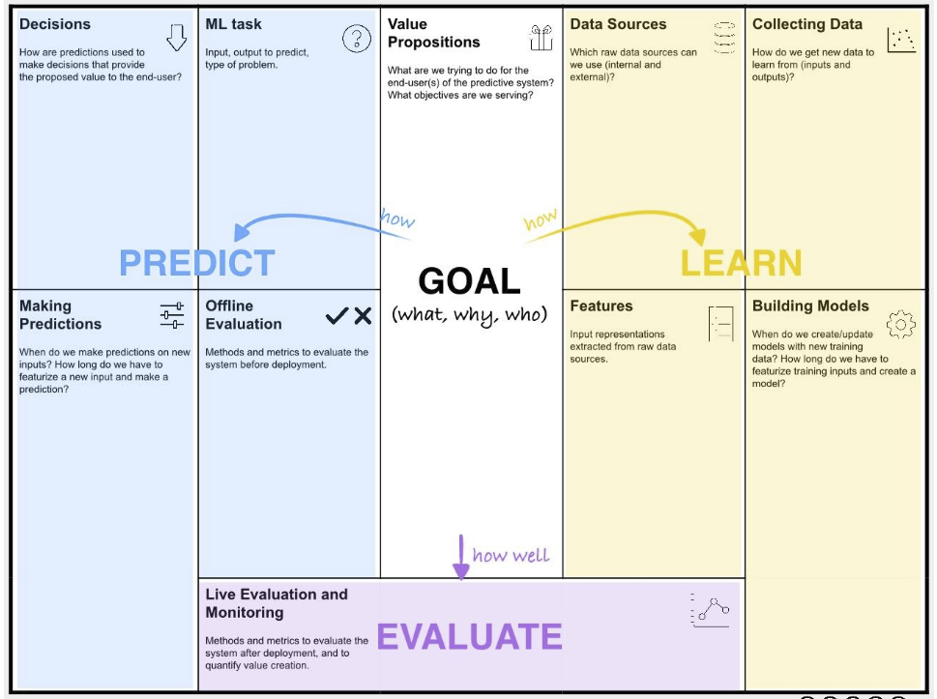
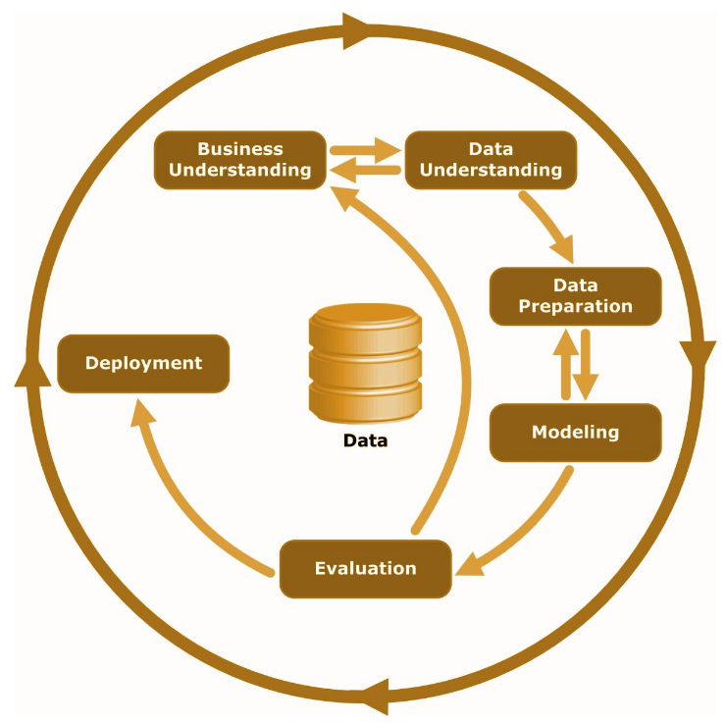
Data Science Solution Approach – Cont.
It used variables like pregnancies, glucose, age etc to predict whether the patient has diabetes or not.
Input: characteristic of diabetes patients
Output: whether have diabetes
By knowing features of patients, healthcare org can develop proactive medical interventions.
This way, it can help more people away from the diabetes.
Pima Indians Diabetes Database
Get information of diabetes patient when they come for treatments in the hospital.
Use the prediction result to test on new patient data we collected one month later. To see whether the result is consistence.
Pregnancies, glucose, blood pressure, skin thickness, Insulin, BMI, Diabetes pedigree function, Age
We make prediction until we have large enough dataset, for example 10,000 patient data. And update the prediction when very 1000 more patient data added into the dataset.
Patient data can be historical but new patient data need to be added every month.

Slide 8
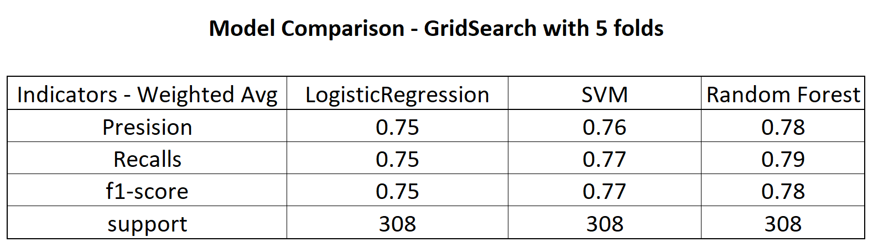
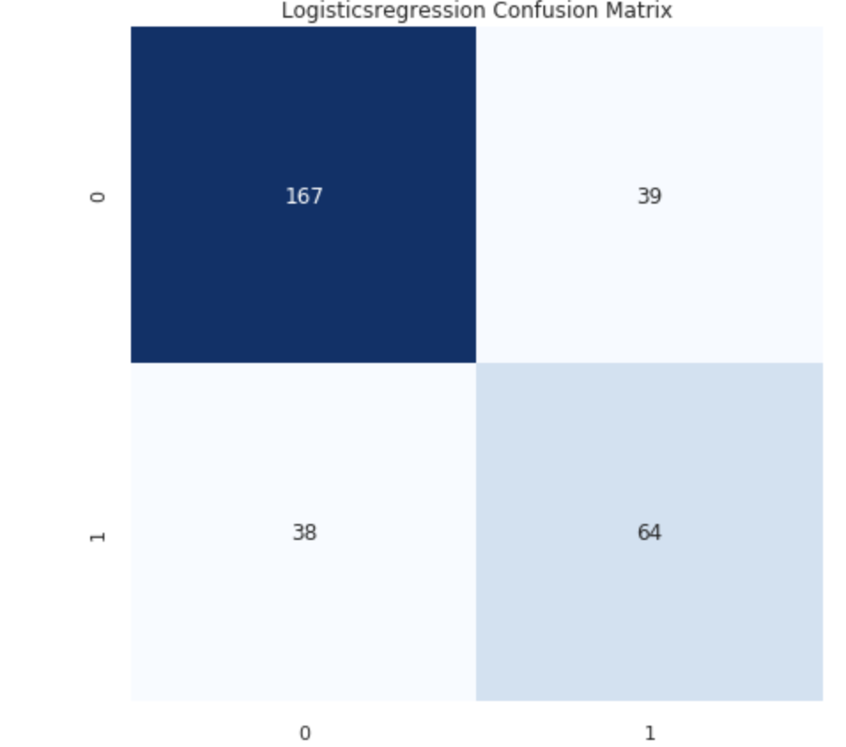
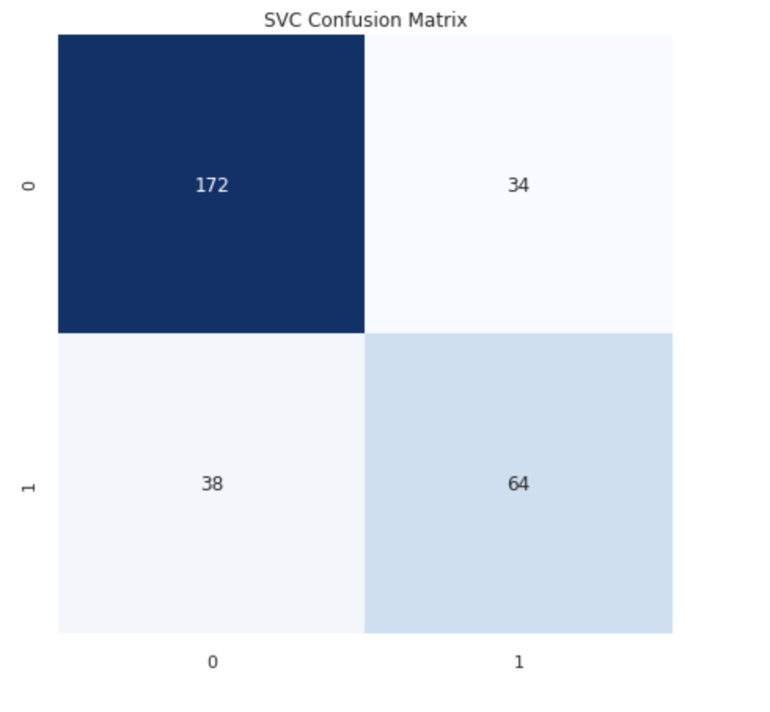
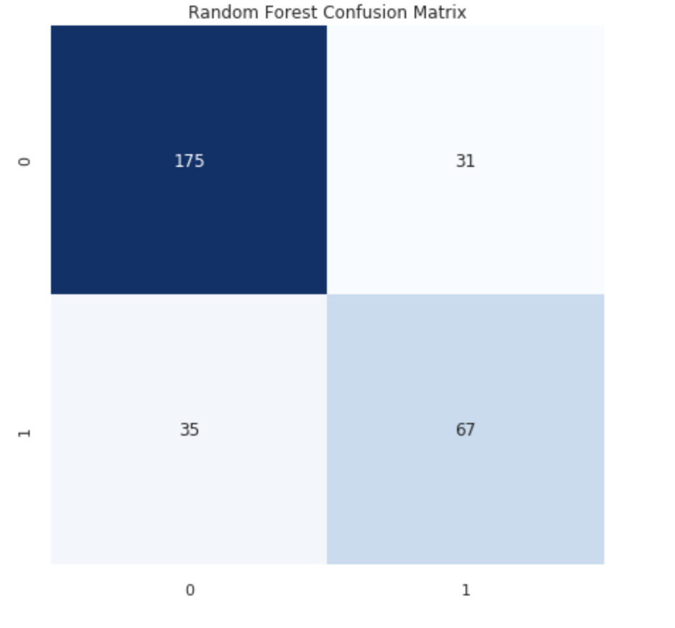
Evaluation

Slide 9
Thank You

